Slide 1
Submitted By TEEGELA SIDDARDHA MEHER (Regd.No:108036846) Under the Esteemed Guidance of Prof. V.VALLI KUMARI Department of CS & SE Andhra University College of Engineering
e-MEDICAL SERVICE MANAGEMENT

Slide 2
What is e-Medical Service Management?
e-Medical Service Management is a web application aimed at revolutionizing the field of medicine. It is targeted to change the way the medical services are provided at Hospitals. So this application is planned to build a virtual home to provide the required services online to all the individuals irrespective of their location. For proper management of the provided medical services this system is built.

Slide 3
How It Works?
Patients and the registered doctors log in to the system with their username/password. New users will have to sign up by providing the basic information like full name, location, address and gender.
Set of doctors from different specializations will be available at particular times in a day and few days a week.
The user(patient) can take appointments for consultation of a specialized doctor. Appointments will be given based on the slot availability and also the availability of the doctor.
Chat window will be activated in the patient profile for consultation with the doctor only during the appointment time allotted.
The Manager handles the registration of doctors, pharmacist and Lab Assistant. All issues raised by patients will also be handled by manager.

Slide 4
Contd.
Patients will be able to order medicines online through this system. Medicine delivery and availability in the e-Pharmacy will be handled by the pharmacist.
Lab Assistant will be able to upload the medical reports of a particular patient thought e-Labs. The patient and the doctor will be able to view the reports.
The system facilitates editing of the medical reports by a doctor if needed. The same will be reflected to the patient.

Slide 5
SYSTEM ANALYSIS
EXISTING SYSTEM:
The existing system poses the drawback of unavailability of doctors or the patient has to wait for hours for appointment.
Limited time of services makes it unavailable at all times.
Lack of proper management of staff information and issue tracking.
Lack of attention in managing the patient data.

Slide 6
Contd.
PROPOSED SYSTEM:
The proposed system thrives to over come the drawbacks of the existing medical services system.
The system is designed with the main motto of serving the needy irrespective of their location and time.
Patient can communicate with the doctor even if they are located in remote places.

Slide 7
Contd.
Along with the discussed facilities the system also provides e-Pharmacy and e-Medical Labs.
Patient’s medical data can be efficiently handled through e-Pharmacy and e-Medical Labs.
All the medical prescriptions and delivery will be handled by Pharmacist though e-Pharmacy.
Medical reports of a patient will be managed by Lab Assistant through e-Medical Lab.

Slide 8
FUNCTIONAL REQUIREMENTS
System Administrator should register the Doctors, Lab Assistants, Pharmacists to the system after a thorough background check. All of them can access the system through a user id and password provided by the system after the registration process is complete. Registration module will take care of maintaining the complete user profile and also the registration procedure.
Provision for taking online appointment for patients.
Doctors should be able to view the medical reports of the patient and give e-prescriptions.
Providing a chat window through which the doctor and patient interact at the given appointment time.
Pharmacists can view the e-prescriptions and can deliver the medicines.
Lab assistants upload the medical reports of the patients which can viewed by the doctors when needed.

Slide 9
NON FUCNTIONAL REQUIREMENTS
Security: Role based secure access of confidential data
Error logging: The system should log the errors
Performance: The system should be able to get a better performance at the peak time.
Scalability: Should be high and cater the needs 2000 users at a time
Availability / reliability: The system should be available 24 x 7
Flexibility : Should be flexible and extendable.

Slide 10
HARDWARE AND SOFTWARE USED
Software
OS for Web server : Windows
DBMS : Oracle
Technologies : Java, HTML 5.0, Struts 2.3, JPA, Toplink1.2 Framework, JSP
Web server : Apache, Tomcat 6.0
Database Server : Oracle 10g
Development Environment
IDE : Eclipse
Processor/RAM/HDD : Pentium/4 GB/75 GB

Slide 11
DBMS Model
RELATIONAL MODEL
In relational model all the data is assumed to be organized in the form of two-dimensional tables. The rows and columns present in the table represent the records and fields respectively. Data management under this model is performed using relational algebra. Each table represents a relational model the pointers to link records are made through the data elements within the same table

Slide 12
Model used for Project
Waterfall Model:
The waterfall model is a sequential software development model (a process for the creation of software) in which development is seen as flowing steadily downwards (like a waterfall) through the phases of requirements analysis, design, implementation, testing (validation), integration, and maintenance.
In waterfall model, the following phases are followed in an order
Design,
Construction,
Integration,
Testing and debugging,
Installation,
Maintenance.

Slide 13
Modules Involved
e-Labs
Medical Report Upload
View medical Report
Medical Report Editing
One-One Chat Application
Contribution to:
e-Pharmacy
e-Prescription View
Checking for medicines availability
Medicine delivery

Slide 14
Design Architecture
PRESENTATION TIER
Web Pages
BUSINESS TIER
Action Classes
PERSISTENCE TIER
Entity Classes and Service Class
DATABASE

Slide 15
Screen Shots
e-Medical Service Management

Slide 16
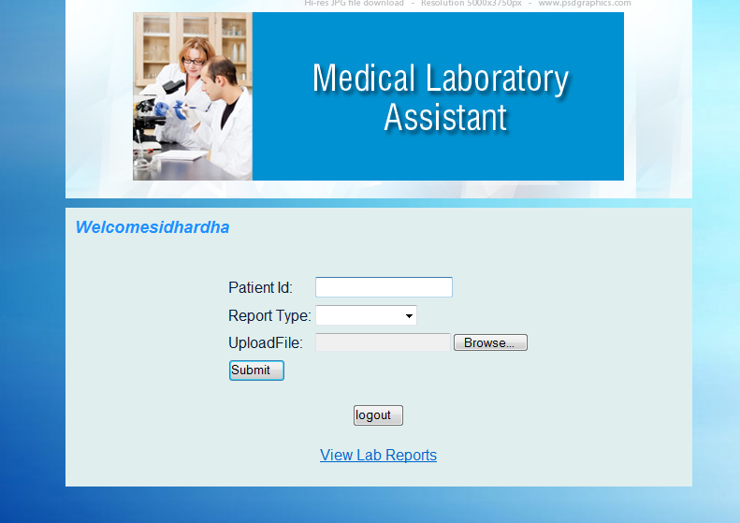
e-Labs
Uploading Medical Lab Reports

Slide 17
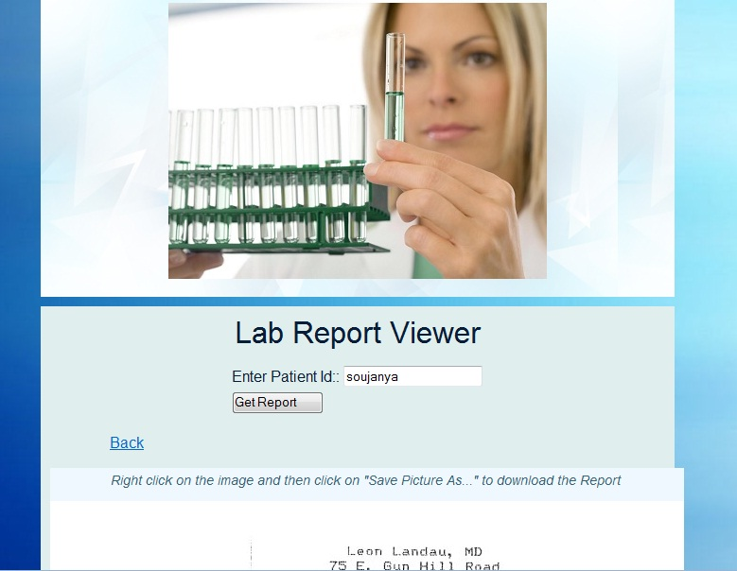
Lab Report Viewer

Slide 18
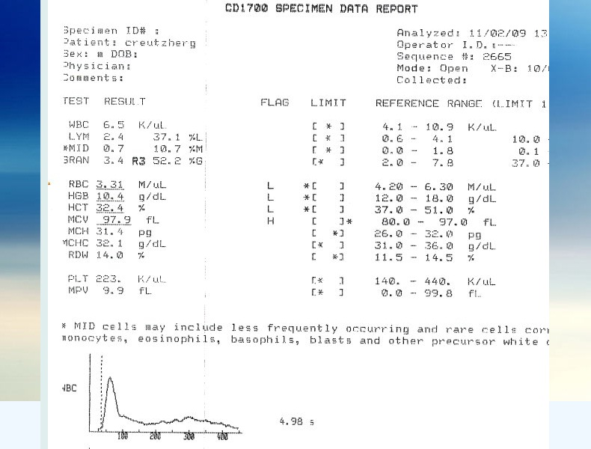
Sample Lab Report

Slide 19
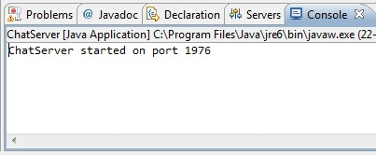
Chat Server

Slide 20
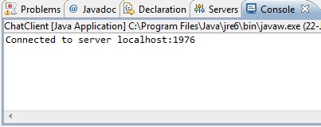
Chat Client

Slide 21
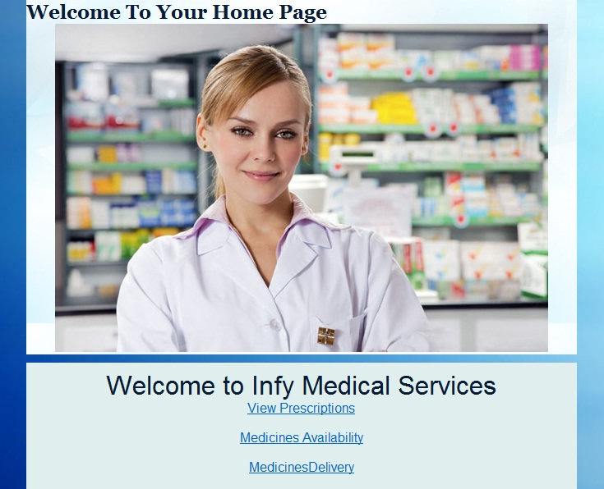
e-Pharmacy

Slide 22
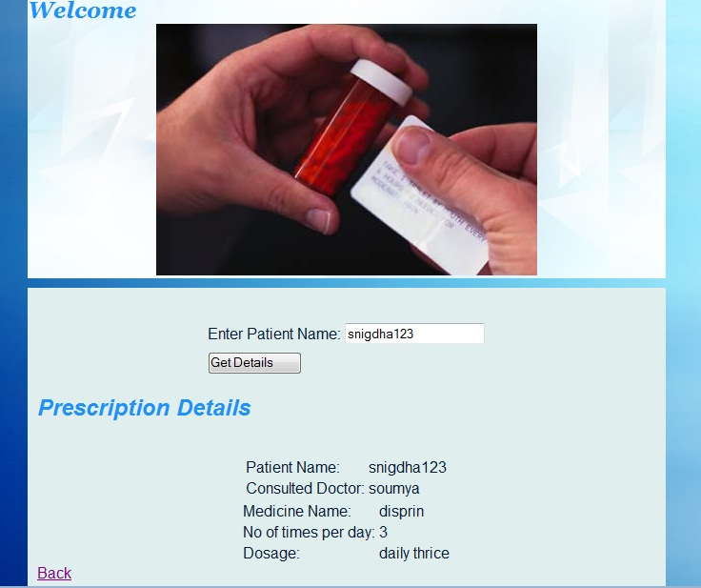
View Prescription Details

Slide 23
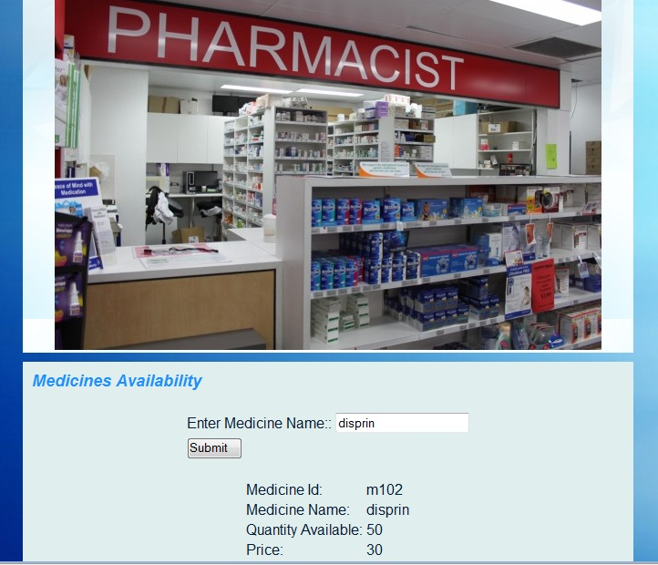
Medicine Availability Check

Slide 24
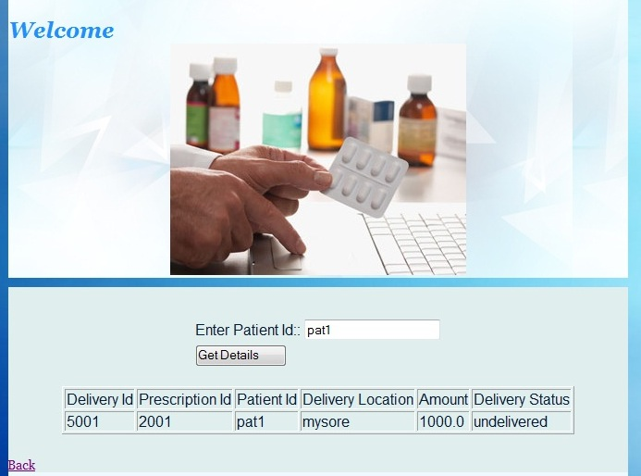
Medicine Delivery Check

Slide 25
Conclusion
e-Medical Service Management is an online service that provides round the clock medical services irrespective of the users location. Patients can communicate with certified doctors at any time through a chat window without having to wait for long hours for appointment. This system also provides a secure repository for storing the patient details such as prescriptions and medical reports. In this way use of paper can be eliminated and also the patient data can be handled efficiently. On the whole, this system makes things easier for the users as all medical services are provided on the click of a button.

Slide 26
THANK YOU

